Slide 1

Parking Lot Team 4
CS20B037 SARTHAK
CS20B030 PREETHI
CS20B029 PRANAV
CS20B023 KARTIK

Slide 2
Outline
5 Classes
2 interfaces
4 vehicle types

Slide 3
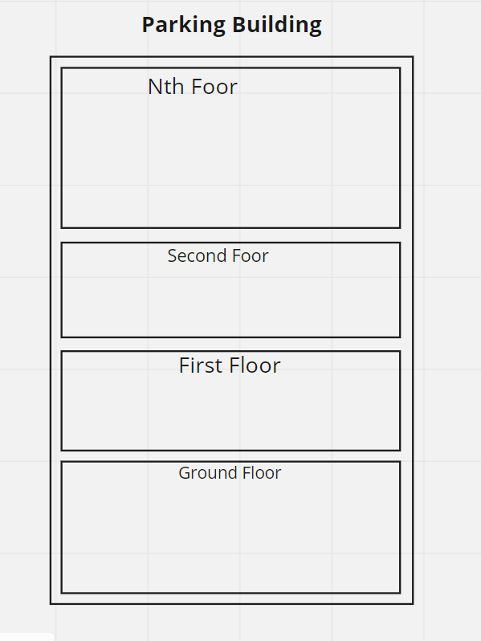
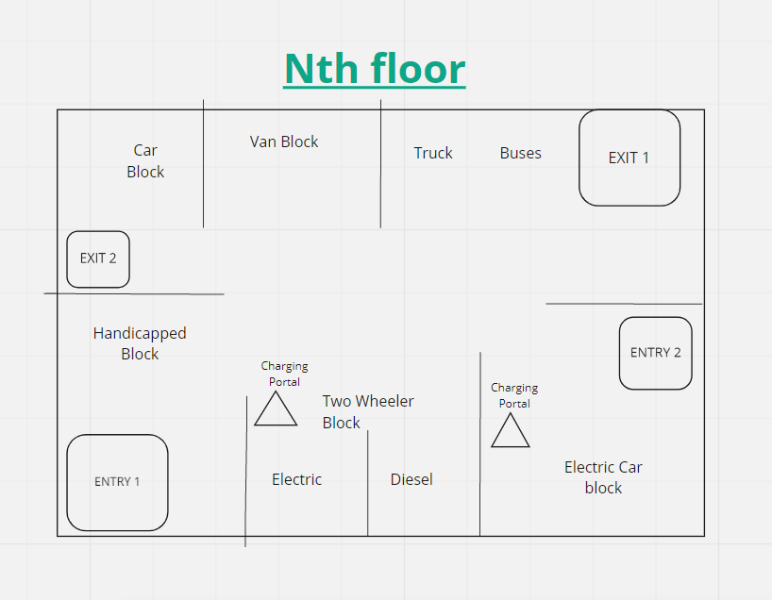

Slide 4
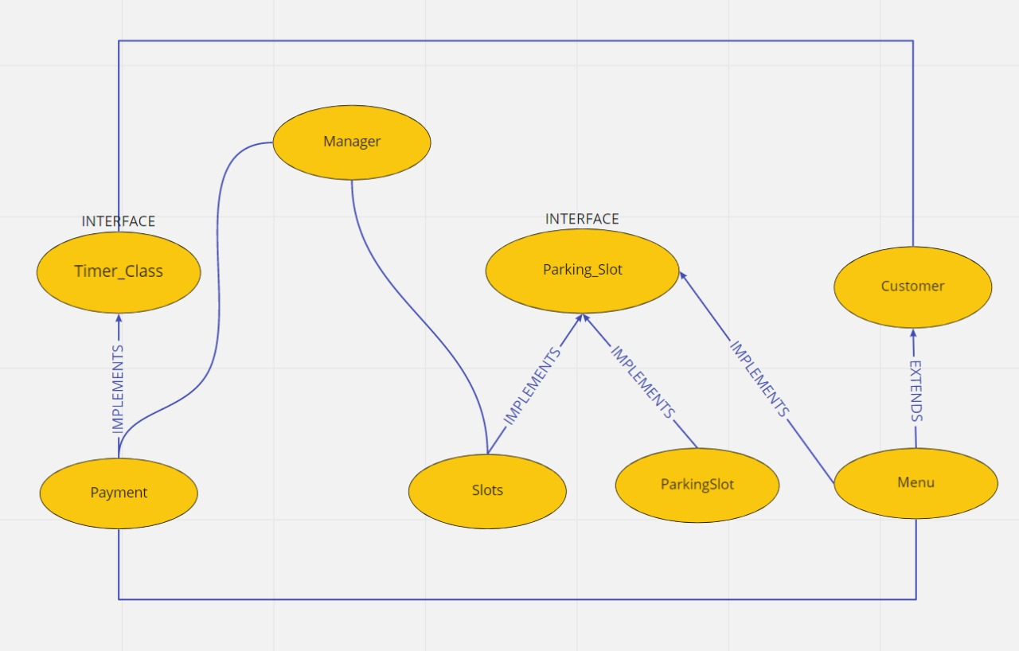
Classes, Interfaces and Inheritance

Slide 5

THANK YOU
-BY team 4

